Slide 1

Analysis of Worldwide & Historical Energy Consumption
Data Analytics, Lighthouse Labs
Marlen Mussayev
Notes:
Hello everyone, my name is Marlen and I’m a Data Analytics graduate here at Lighthouse Labs. I’m transitioning into Data world from Oil&Gas background, with over 6 years of experience as a Reservoir Engineer. My final project presentation topic is Analysis of Worldwide & Historical Energy Consumption.

Slide 2
Project Flow Structure
Getting data ready to analyze (discover, clean, make relationships, joins etc.)
Analysis of the data:
Finding/Comparing trends
Analyzing relationships & correlations
Building regression model
Creating interactive visualizations
Exploratory Data Analysis (EDA)
Hypothesis Testing and Statistical Analysis
Notes:
Here Is Project Flow structure and what was done during this work, I have started with getting data ready to analyze, basically getting familiar with data, cleaning, joining etc.
Next Part was analysis:
Performed initial data exploration to understand the structure, distribution, and basic statistics of the data.
Finding & comparing trends and insights
Hypothesis Testing and building regression model to forecast
And I finished with visualization

Slide 3
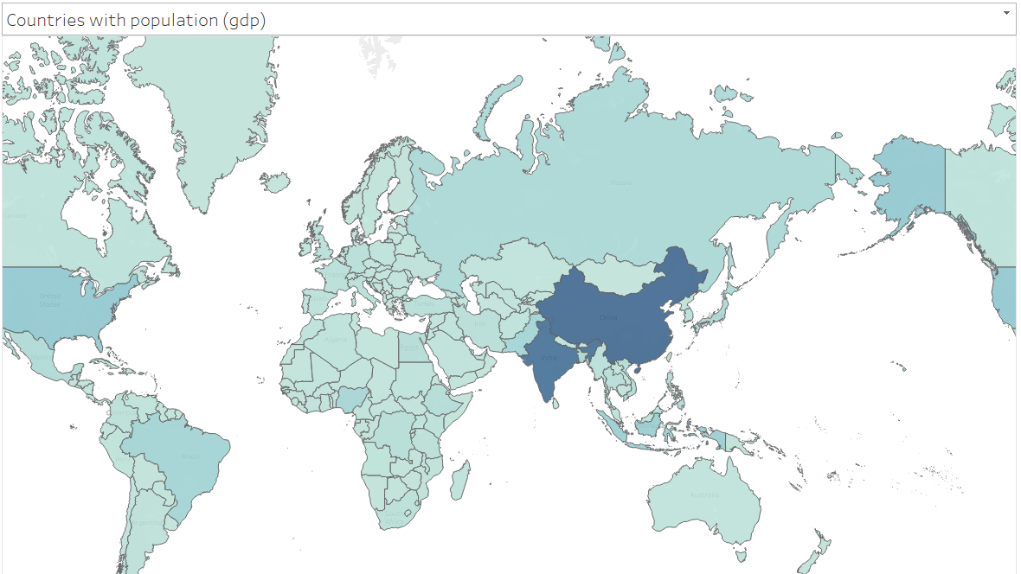
Analysis of the data:
Terms used in the project:
Fossil Fuel: Oil, Natural Gas & Coal
Renewables Energy: Wind, Solar & Hydro
GDP & Population
Notes:
Since I have limited time of presentation, I will show some insights from the project, however if you want full picture please feel free to jump into my github page. I will present link later in presentation. I was working with World Energy consumption history data.. And here are terms that I will be mentioning in the presentation. Fossil Fuel includes Oil, natural gas and Coal. Renewable energy includes Wind, Solar & Hydro.

Slide 4
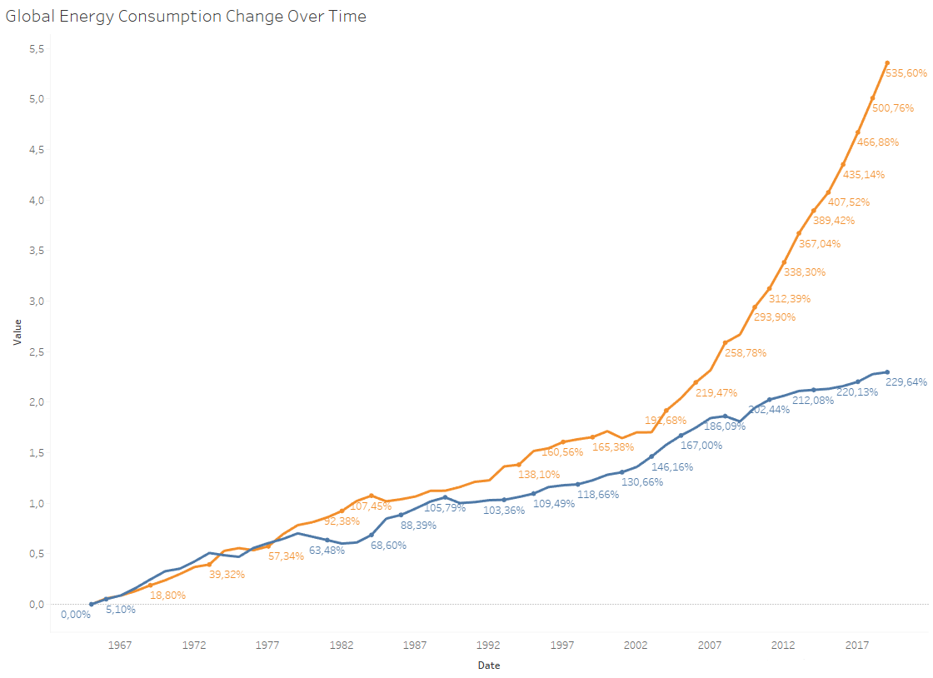
Analysis of the data:
Notes:
Let’s look into comparison of the history of fossil fuel and renewables energy consumption: Here orange line represents renewable energy consumption, and as you can see it’s increasing rapidly up to 500% change from the first date, whereas Fossil fuel consumption increased up to 200%. And we can see that the real change in trends kicked-in in 2003. Let’s have a closer look on that:

Slide 5
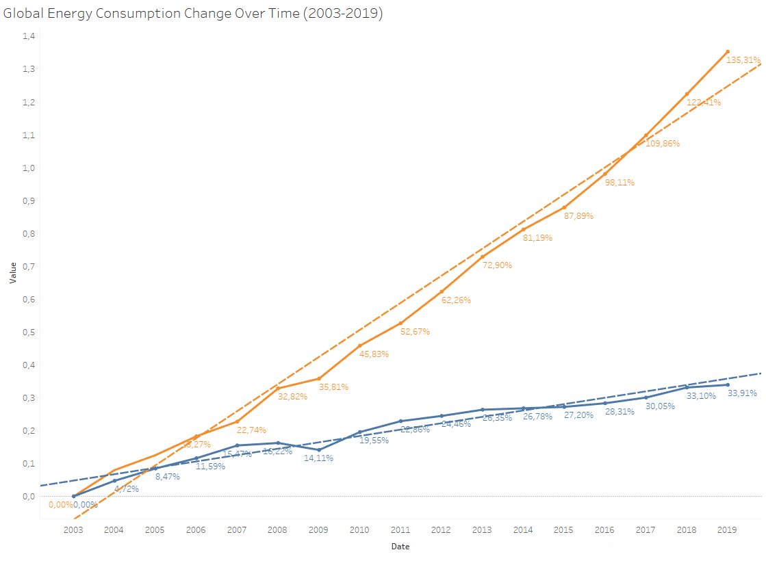
Analysis of the data:
Notes:
This graph shows same trend but only from 2003, and we can see that renewable energy consumption doubled since 2003. Let’s break it into more details to see what could be the reasons of that:

Slide 6
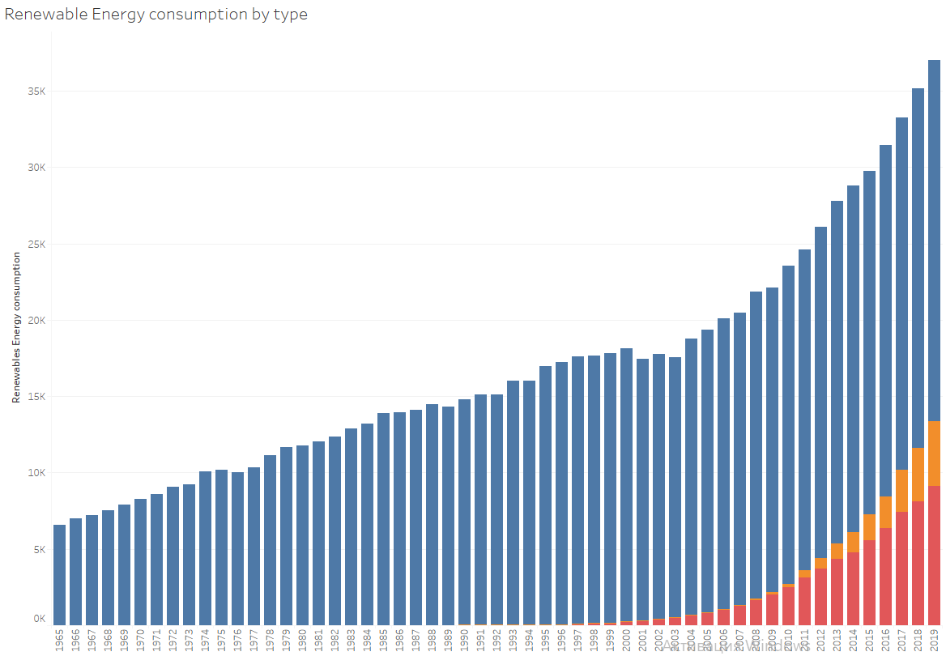

Analysis of the data:
Notes:
This is the understanding of type of renewables energy consumption, and how they changed. As I mentioned earlier we have hydro, solar and wind as a part renewable energy. And we can see that in 2003 Wind consumption kicked-in and followed by solar energy. And they were only increasing since then.

Slide 7
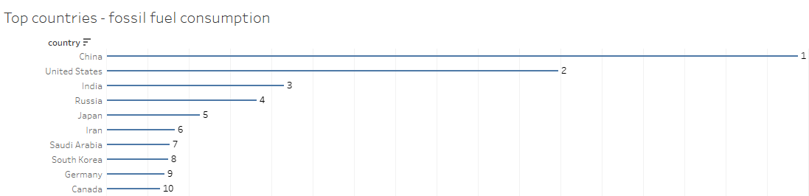
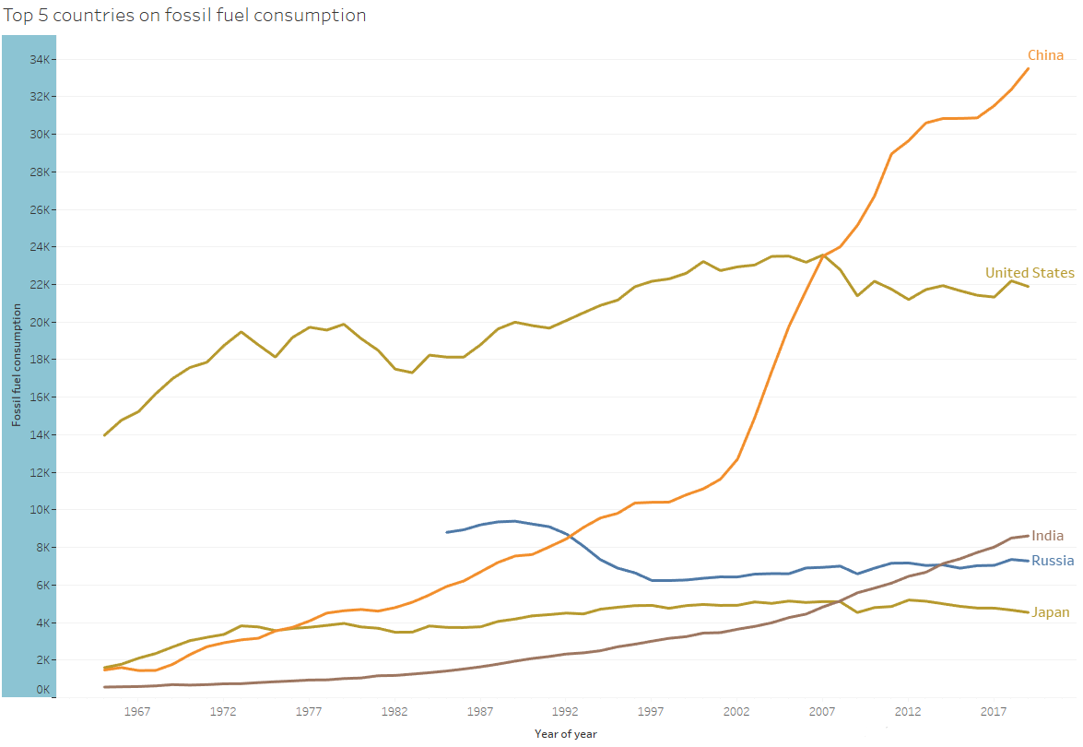
Analysis of the data:
Notes:
Now, let’s understand the behaviour of fossil fuel consumption. Here are the top 10 countries in terms of fossil fuel consumption, top 5 of them includes China, USA, India, Russia and Japan. From the graph below you can see that most increase in consumption showing China and India, while other countries in top 5 are quite stable. Let’s see what could be a reason

Slide 8
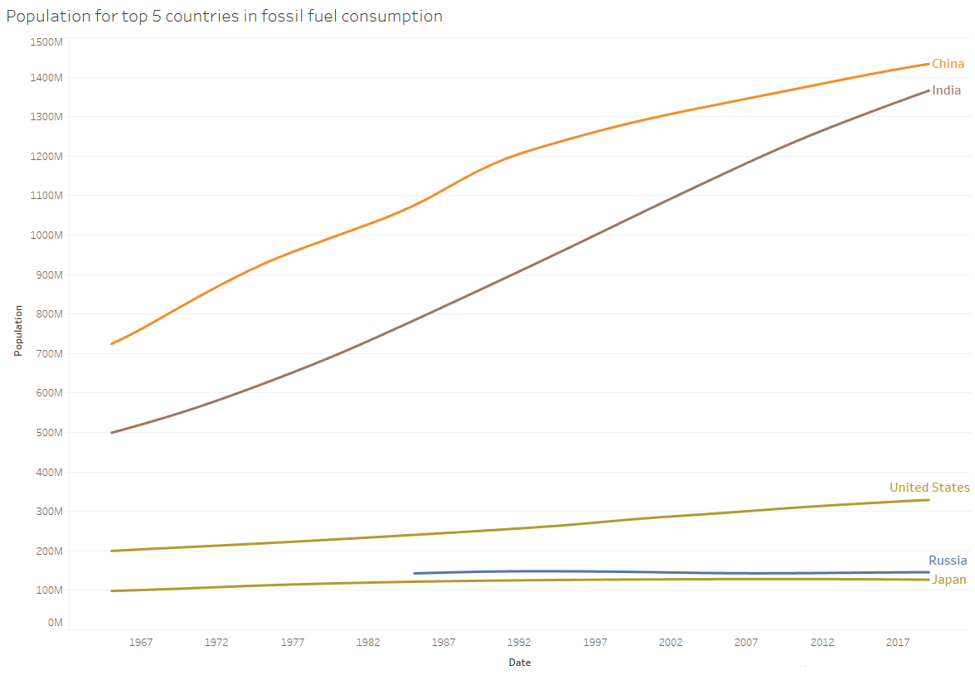
Analysis of the data:
Notes:
This is the graph of population in the same 5 countries. And we can see that China and India are the only ones with dramatic increase in population. Let’s see how population correlates with energy consumption

Slide 9
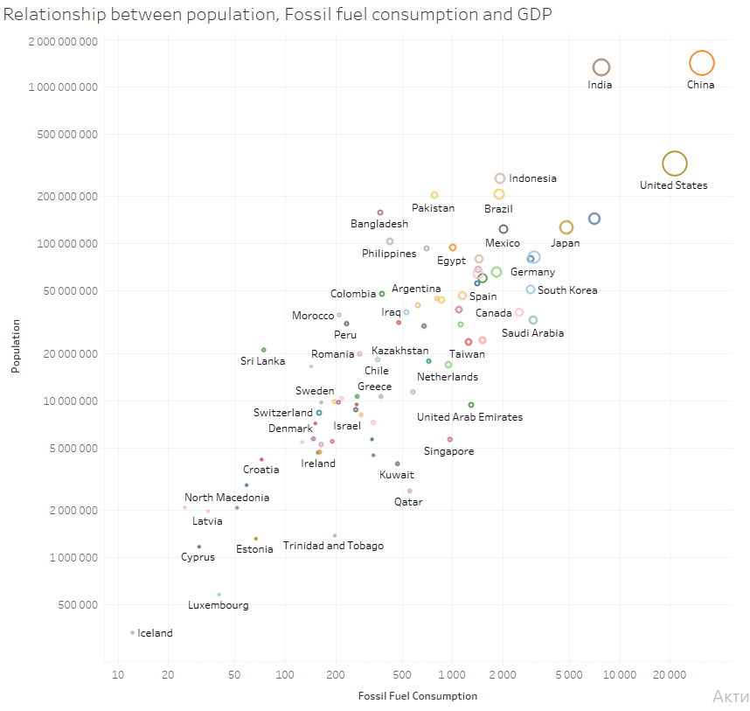
Analysis of the data:
Notes:
It can be seen from this scatter plot that Population has a positive correlation with Fossil Fuel Consumption, meaning more people live in the country, more Fossil Fuel that country consume. I also added GDP of the countries as a size for the points, which means bigger is circle more GDP that country has, but we will investigate that later.

Slide 10
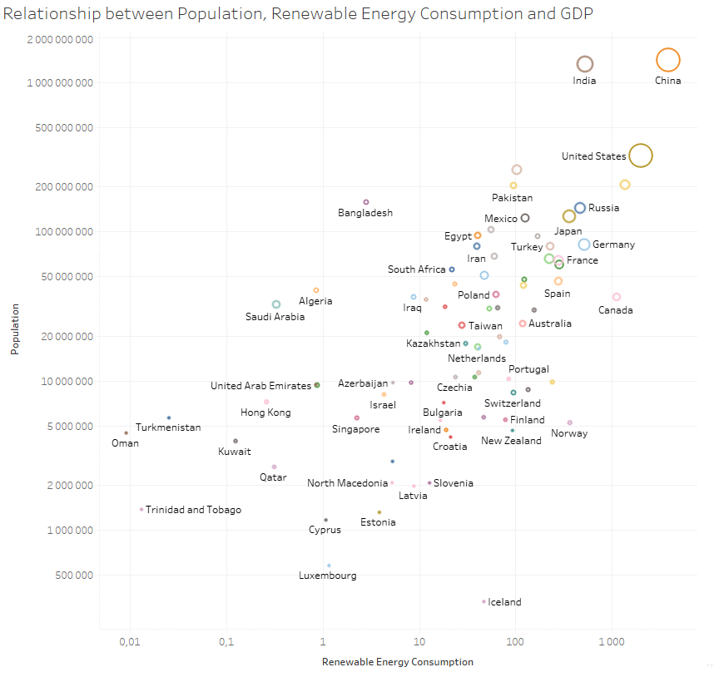
Analysis of the data:
Notes:
At the same time, after the same analysis I could see that Renewable energy doesn’t correlate with population, so let’s dive more into details

Slide 11
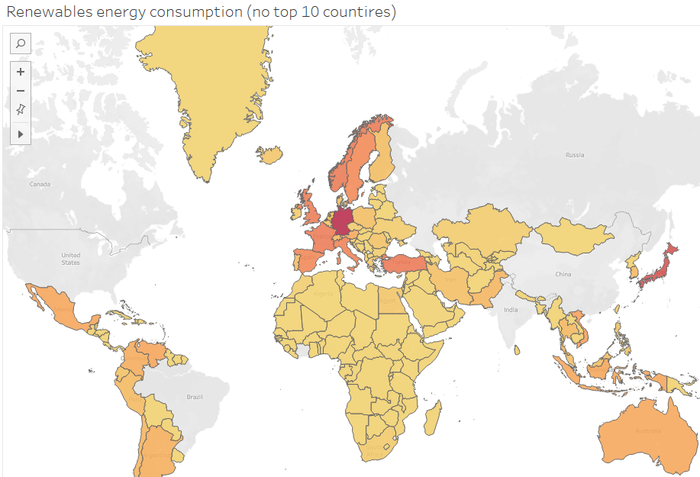
Analysis of the data:
Notes:
This map represents Renewable Energy consumption, I filtered out top 10 countries, to see how renewable energy consumption distributed within other countries. Going through some extra analysis, I found that countries with most renewable energy consumption are what so called 1st world countries, mainly Western Europe, Turkey and Japan.

Slide 12
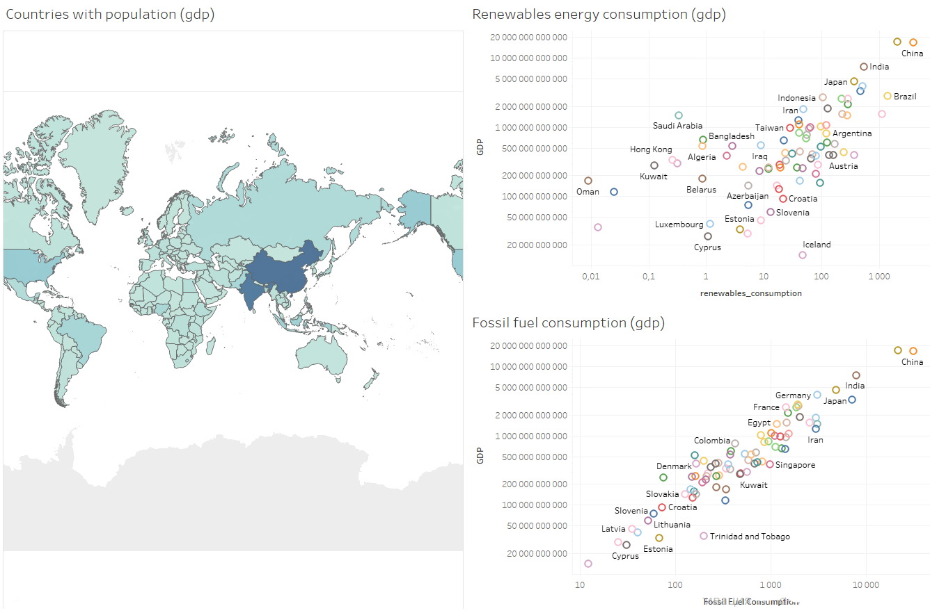
Analysis of the data:
Notes:
At the end, I would like to share the correlation between GDP and energy consumption. Renewables energy consumption is more scattered and doesn’t correlate with GDP and as we understood doesn’t correlate with population as well. However, Fossil fuel consumption has a positive correlation with GDP and population, meaning that more advanced countries with higher population need more fossil fuel to provide for its needs.

Slide 13
Conclusion
Renewables energy consumption is still increasing rapidly
Clear correlation between fossil fuel consumption & GDP, population
Top countries that consume renewables energy are the 1st world countries
To see more insights, please visit: My Github page or connect on LinkedIn
Notes:
To conclude,
Renewables energy consumption is still increasing rapidly.
Clear correlation between fossil fuel consumption & GDP & population
Top countries that most consume renewable energy are the 1st world countries
To see more insights, you could visit My guthub page or contact me on LinkedIn

Slide 14
Thank you!
Notes:
Thank you very much for your attention

